Slide 1
Guide on the Side Version 3
Tony Mei
Student Developer 2016

Slide 2
Table of Contents
Introduction…………………………………………………………………………………………Slide 3
How to install……………………………………………………………………………….........Slide 4
How to create a tutorial………………………………………………………………….…Slide 5-6
Adding text……………………………………………………………………………………....Slide 7-8
Adding new page…………………………………………………………………………..Slide 10-13
Adding Questions………………………………………………………………………….Slide 14-18
Adding Definitions…………………………………………………………………………Slide 19-21
Adding URL Link…………………………………………………………………….........Slide 22-25
Adding Pictures…………………………………………………………………………….Slide 26-27
Adding Free Response Boxes……………………………………………………….. Slide 28-30
Adding a Quiz………………………………………………………………………………. Slide 31-35
Adding Chapter Headings……………………………………………………………..Slide 35-37
More settings………………………………………………………………………………..Slide 38-41

Slide 3
What is Guide on the Side?
Create interactive tutorials
Can help users navigate the webpage
Ability to ask the user questions to enhance understanding
Demo: http://code.library.arizona.edu/gots-sample/tutorial/wikipedia-demo
Another Demo: http://www.library.arizona.edu/applications/quickHelp/tutorial/searching-the-ua-library-catalog

Slide 4
How to install Guide on the Side?
If you already deployed Guide on the Side on AWS, ignore the rest of slide.
Download here: http://code.library.arizona.edu/gots/
We tested on Ubuntu running on Oracle VM Virtual Machine so you can download and set up those too
Follow this tutorial: https://github.com/ualibraries/Guide-on-the-Side/blob/master/README.md#about
What we did differently was that we skipped steps 5 and 6
For step 7, we encountered an error that states something along the lines of “My SQL is missing or could not be created”. We manually installed php5-mysql package
Always use sudo before any command

Slide 5
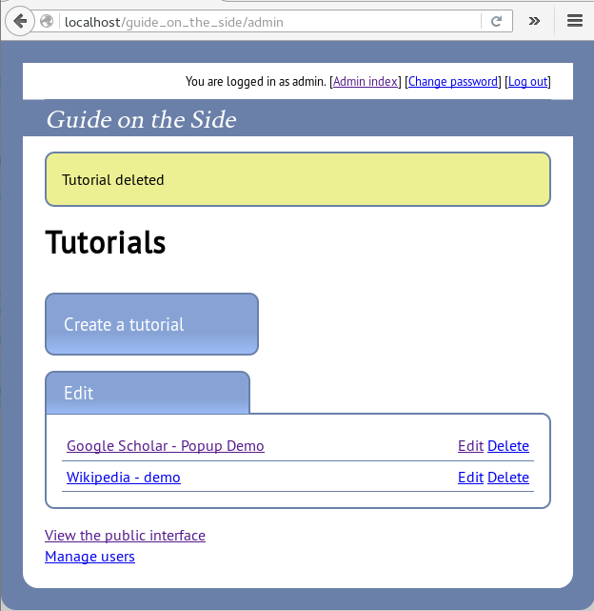
How to create a tutorial
Once you have everything set up, go to http://localhost/guide_on_the_side/admin or if you deployed on Amazon Web Services, PublicDNS/admin
Once in, click on Create a tutorial

Slide 6
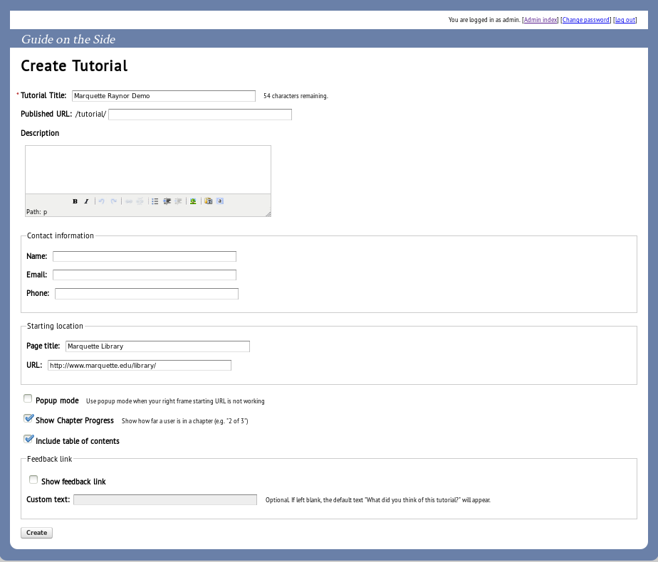
You will be greeted with many options. Some are self explanatory. Not all fields are required.
Here, I set up my tutorial.
Please consider starting location which is what website you want the guide to be interacting? Here I had the Marquette Library Website.

Slide 7
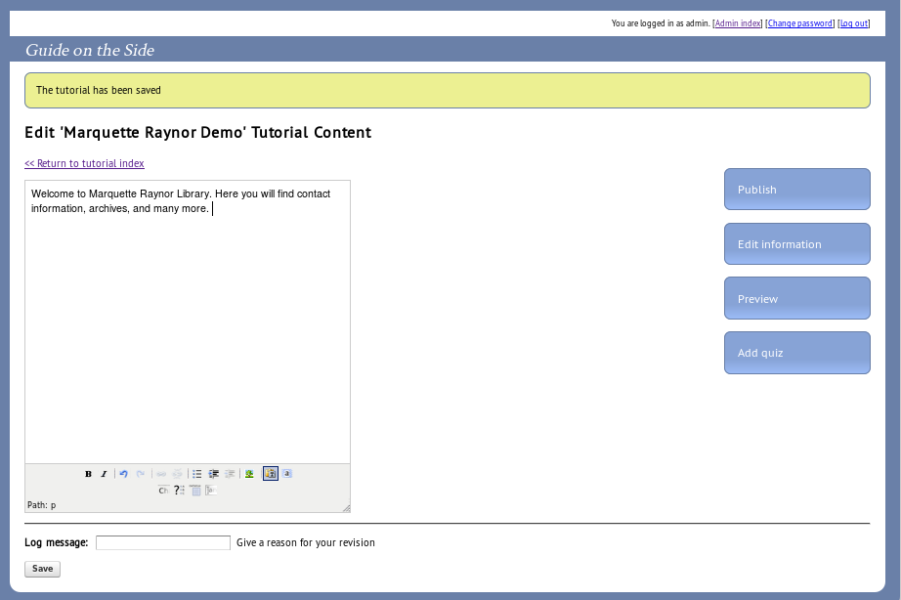
Adding text
Here you can add text to the textbox and you have options like Bolding and Italicizing and other common word processing tools.
You can always preview it to see what it looks like.

Slide 8
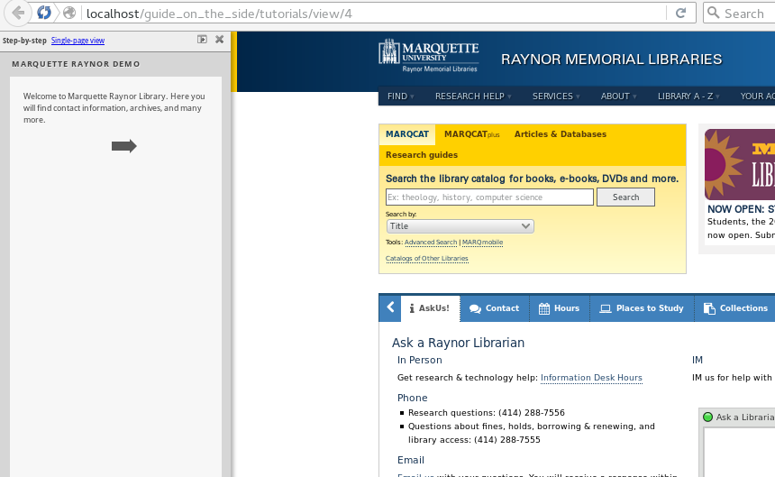
Adding text preview
See this arrow which is used to switch between pages? Continue on to next slide to add multiple pages on the guide

Slide 9
Adding new page
Click on the button with the line over CH

Slide 10
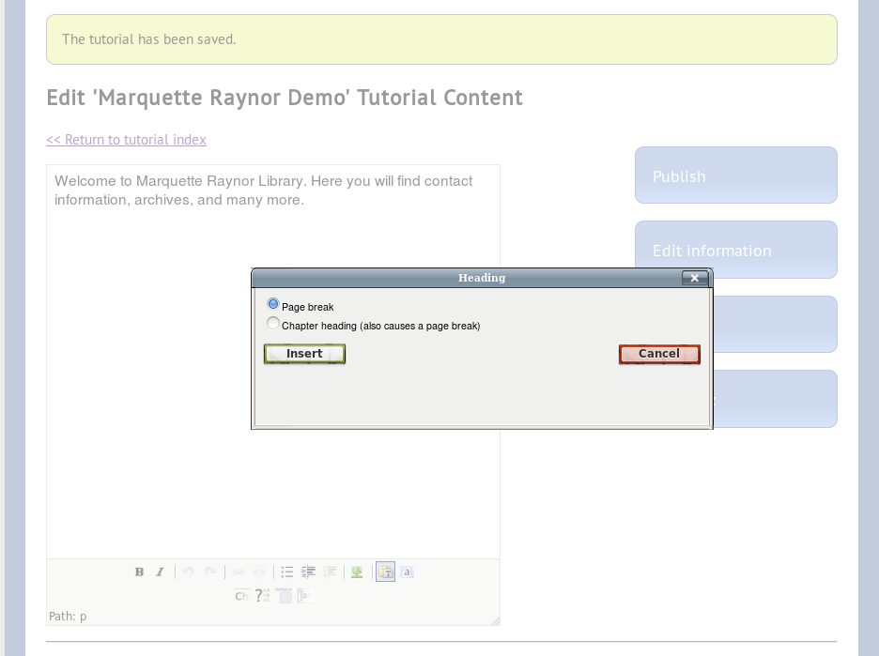
Adding new page
Click insert to Page Break

Slide 11
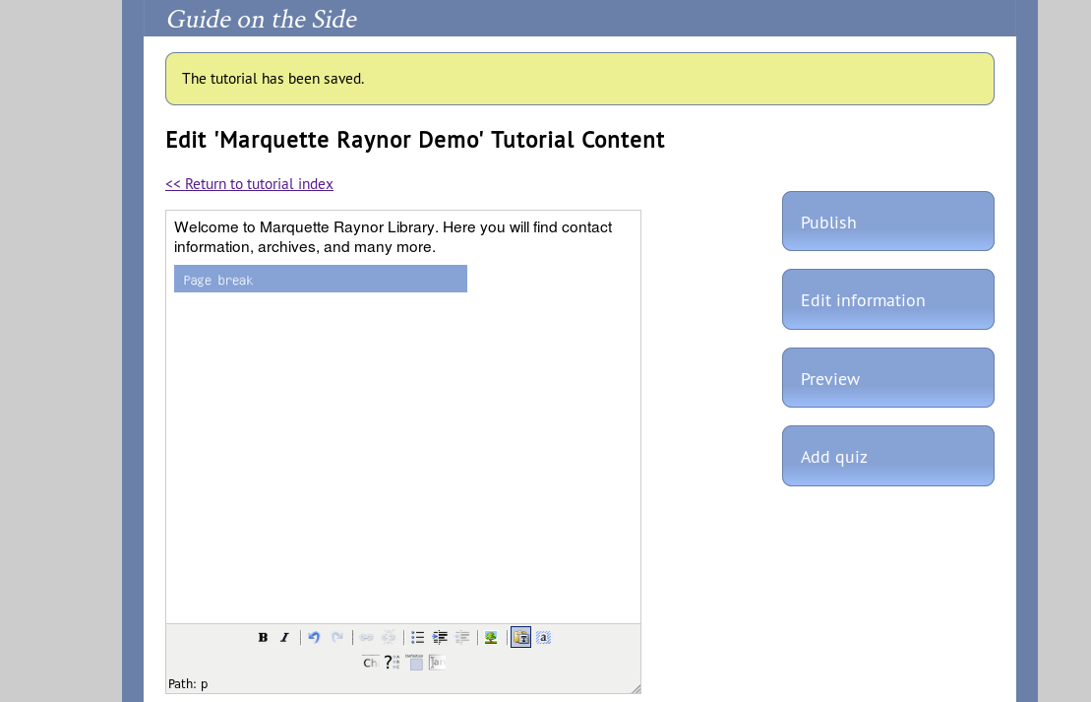
Page Break will be added.

Slide 12
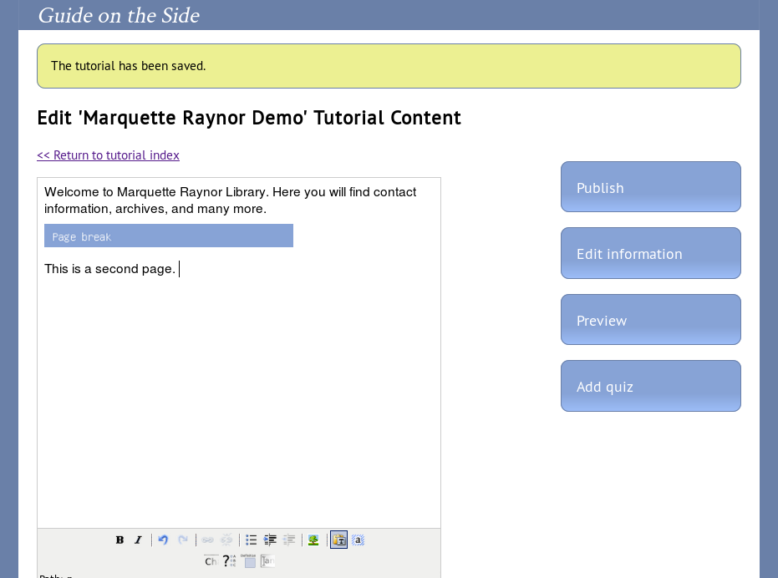
I will type in text after Page Break

Slide 13
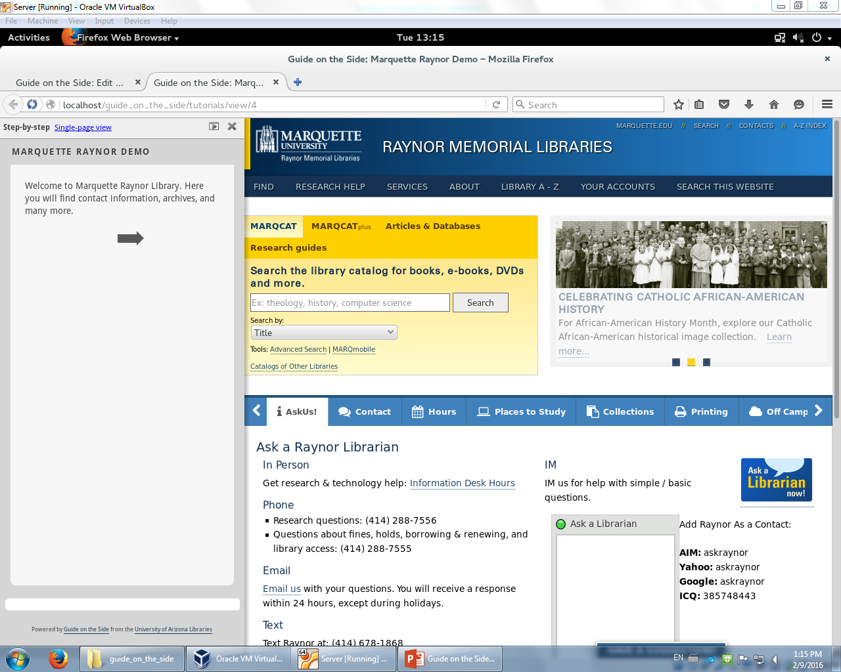
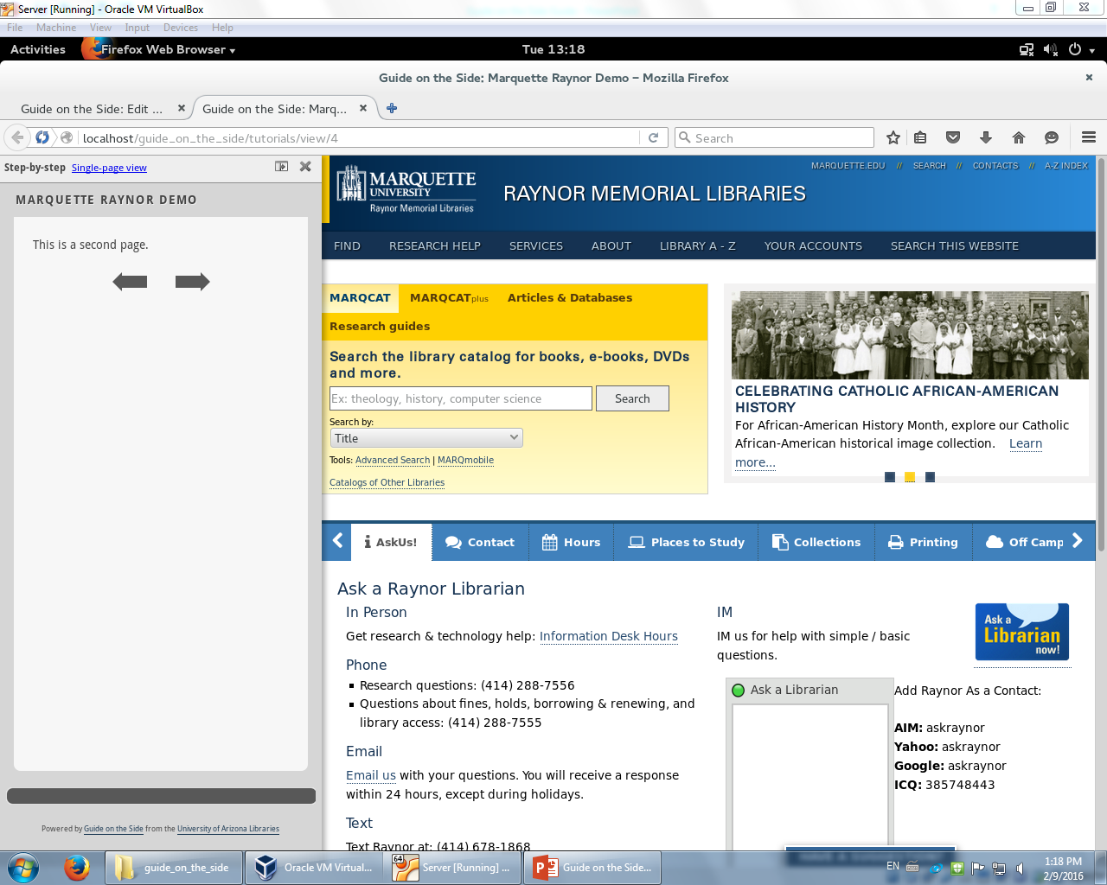
Once you click on the arrows, it will switch pages

Slide 14
Adding Questions
In order to be interactive, the guide needs to ask questions for the user to answer.
Click on the button with the question mark.

Slide 15
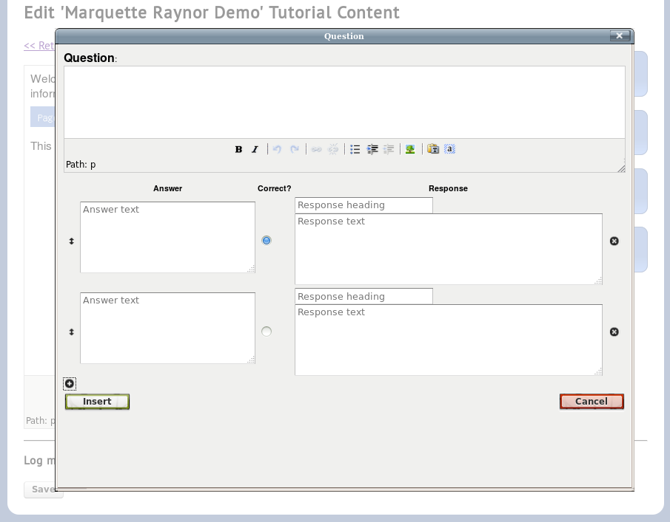
Question will be in the format of a multiple choice. Type question here.
Plus button adds more choices
Click insert once you are done

Slide 16
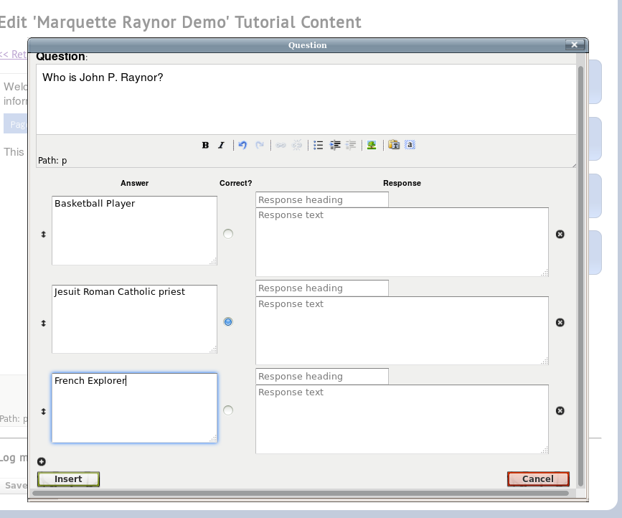
Question Demo

Slide 17
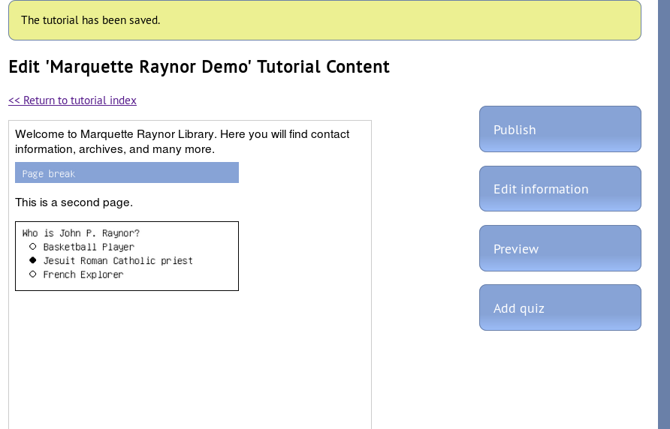

Slide 18
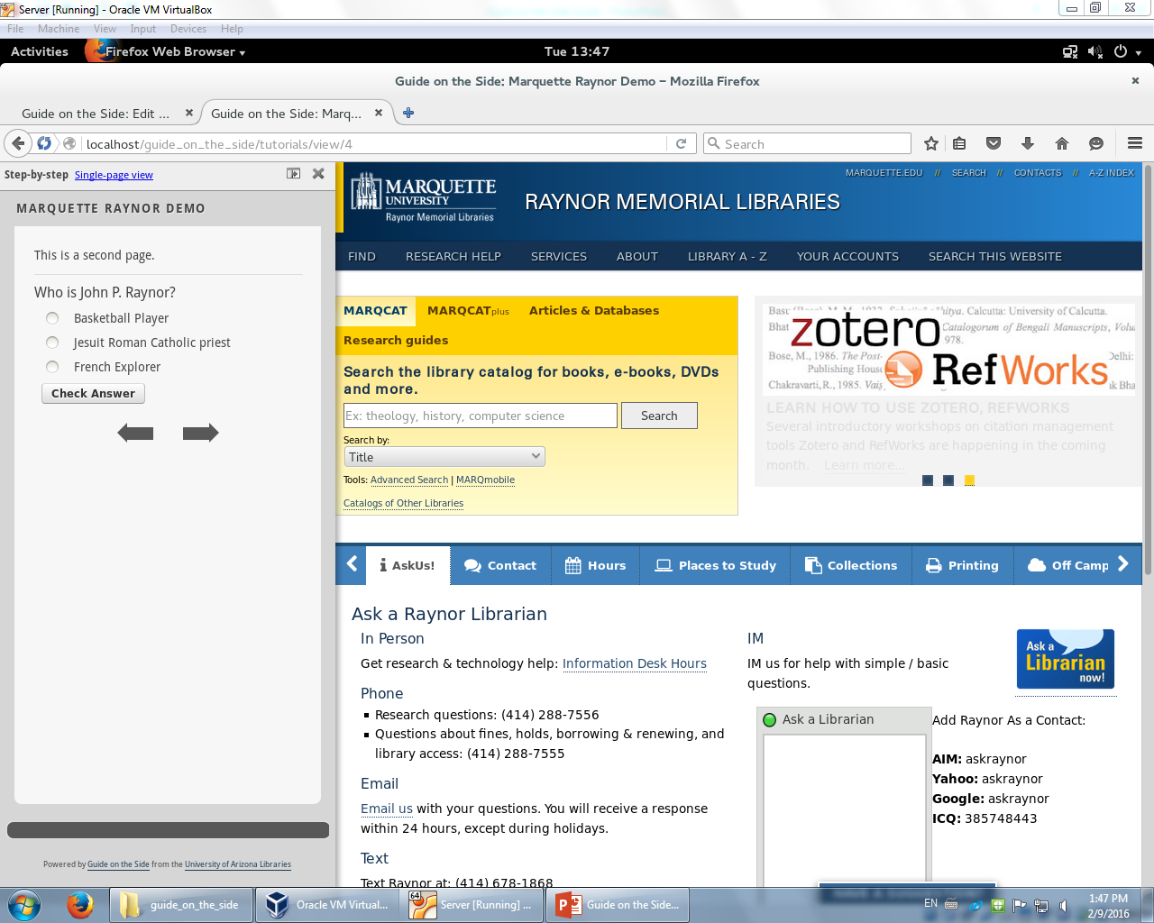
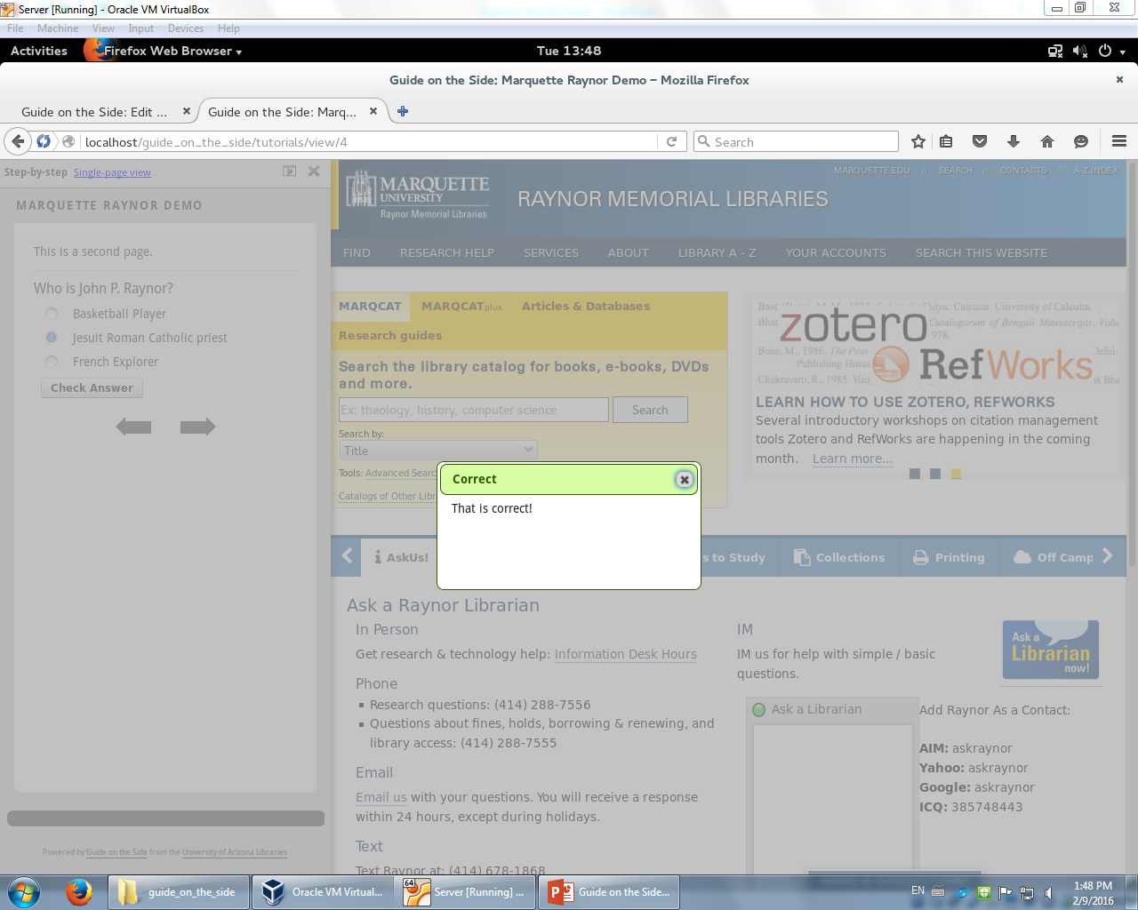

Slide 19
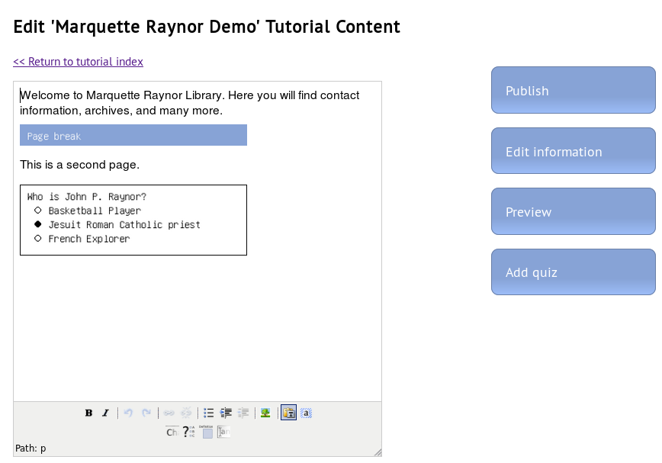
Adding Definitions
Guide needs to have definitions in case user doesn’t know certain words, people, etc.
Click here to add definitions.

Slide 20
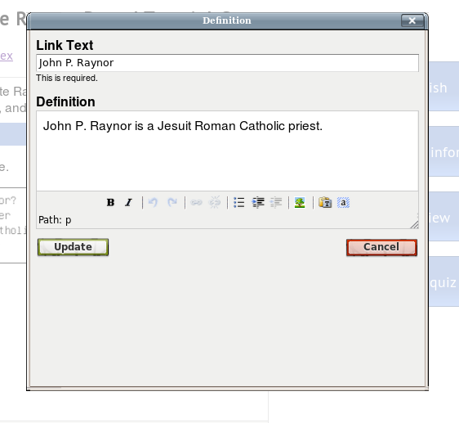
Definitions Demo
Say the user wants to find more about John P. Raynor. I used the name as the Link Text.
Then I provided definitions/description about the person

Slide 21
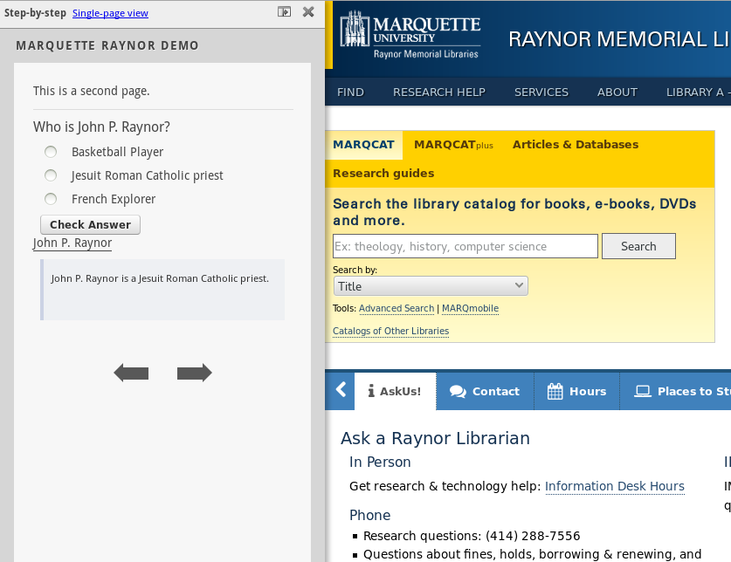
If John P. Raynor is clicked, it will show the definition I made.
BUT WHAT HAPPENS IF THE USER WANTS TO FIND OUT MORE ABOUT THE PERSON? WE CAN LINK THE USER!

Slide 22
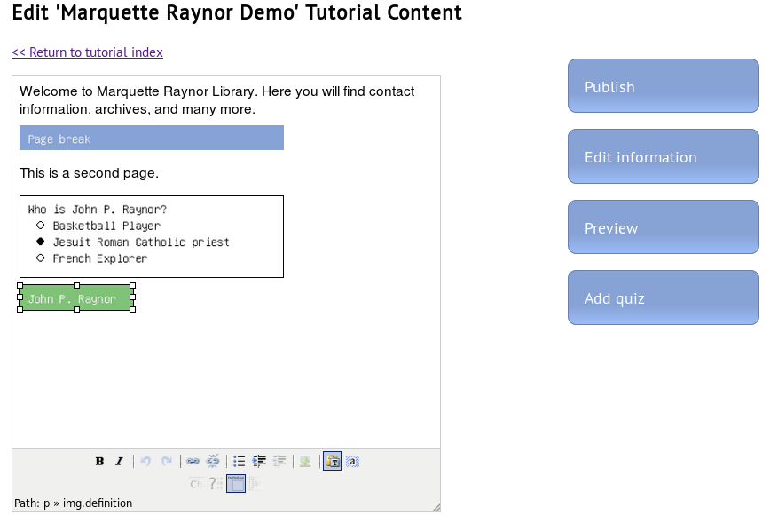
Adding URL Links
You can click on John P. Raynor or you highlight any text and click this button.

Slide 23
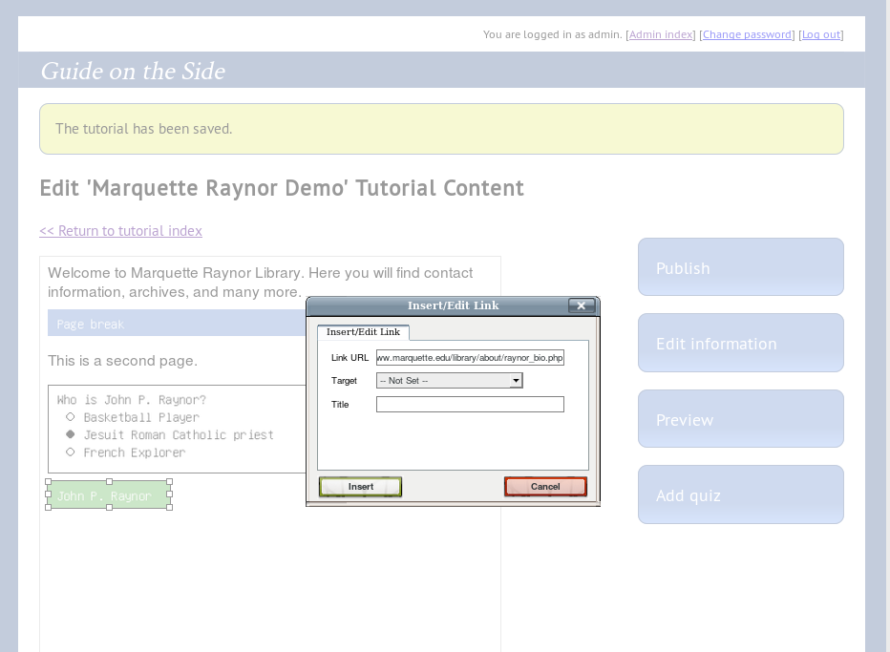
Here you can specify the URL link that will open when the user clicks on John P Raynor or any text. You can also specify the target whether the URL page opens in a new window or same or others.

Slide 24
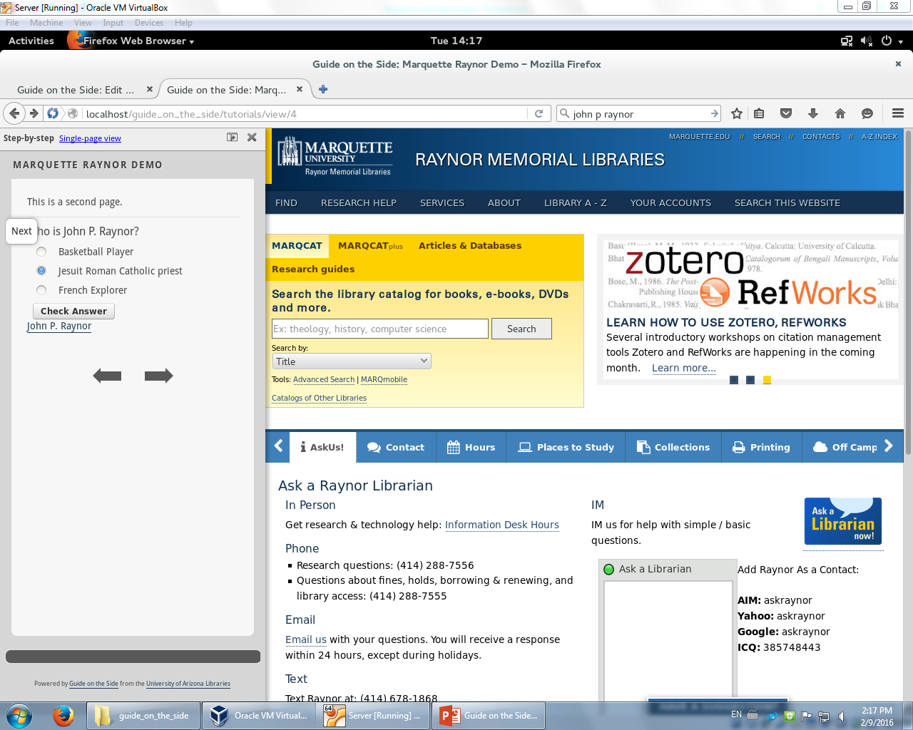
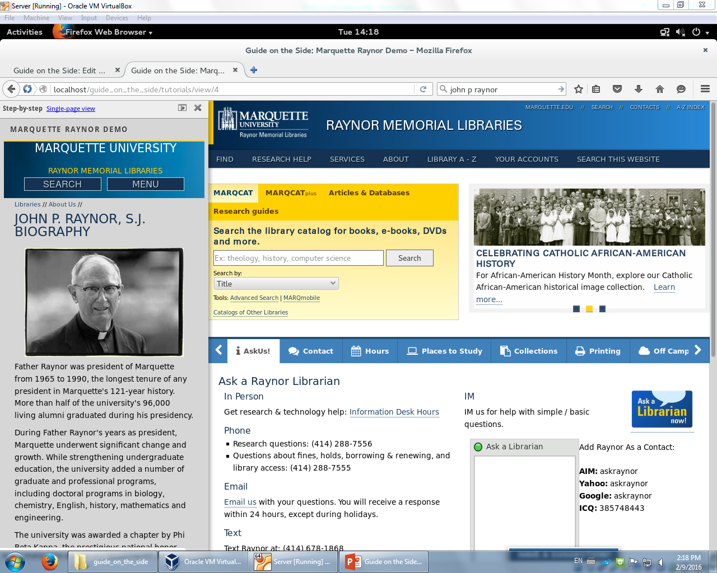
Once you click on John P. Raynor, it will show the page of the URL you provided. Note that you can set to where you can have the page loaded in a new window or same window or others.

Slide 25
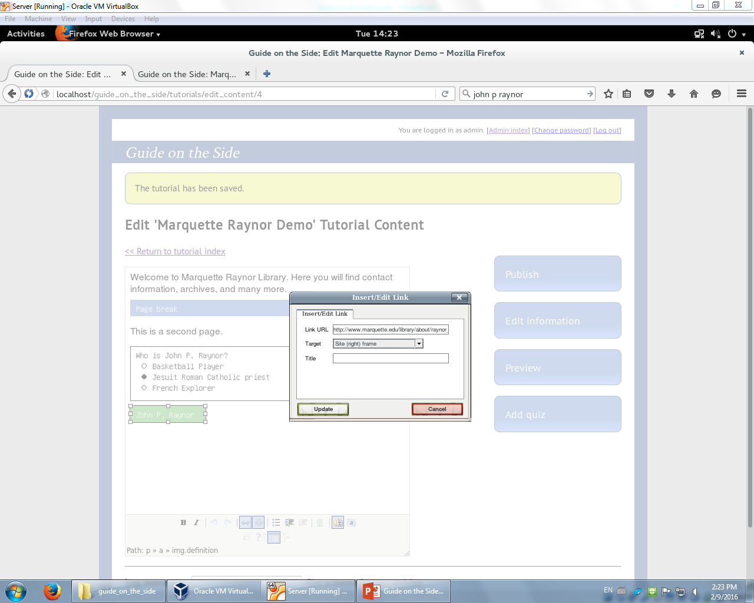
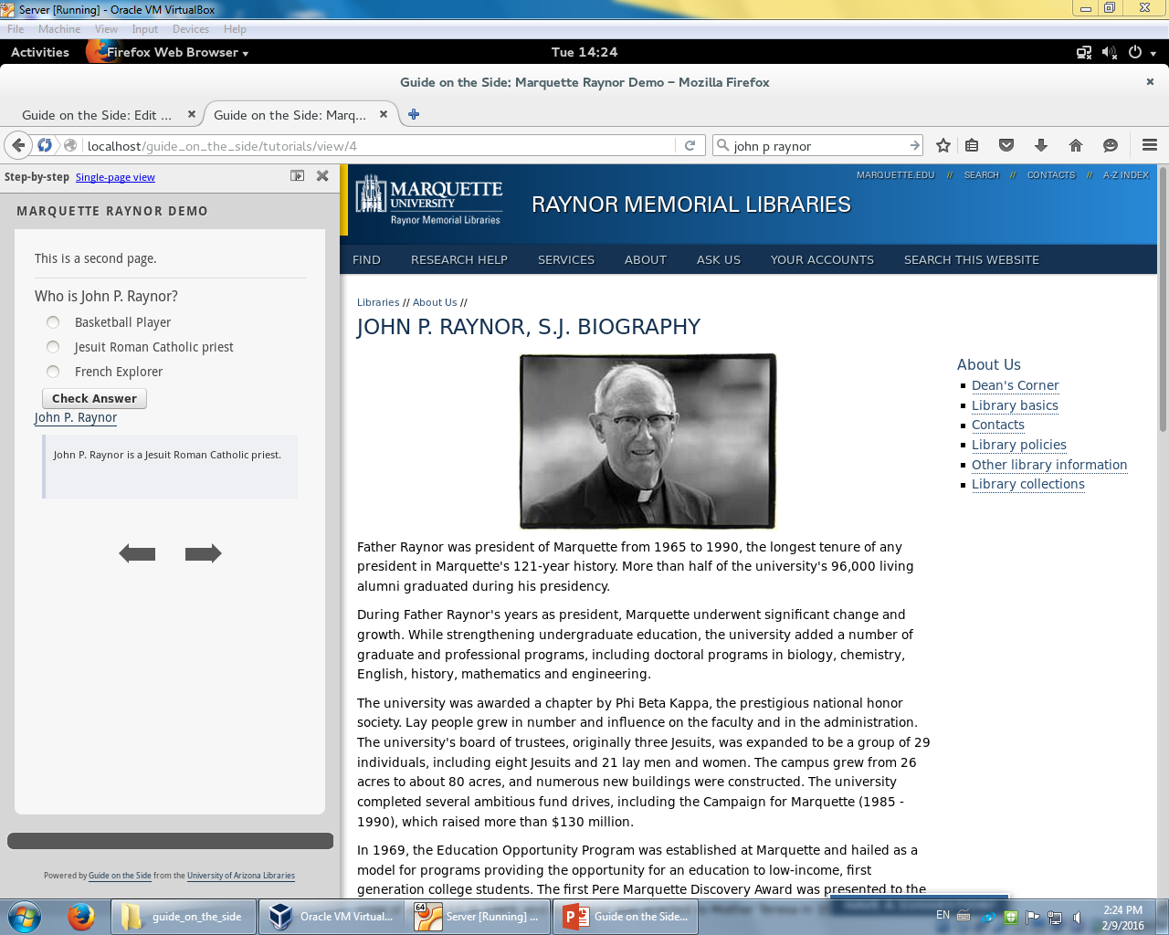
This is what happens when my target is set Site (right) frame. I personally think this is the best option.

Slide 26
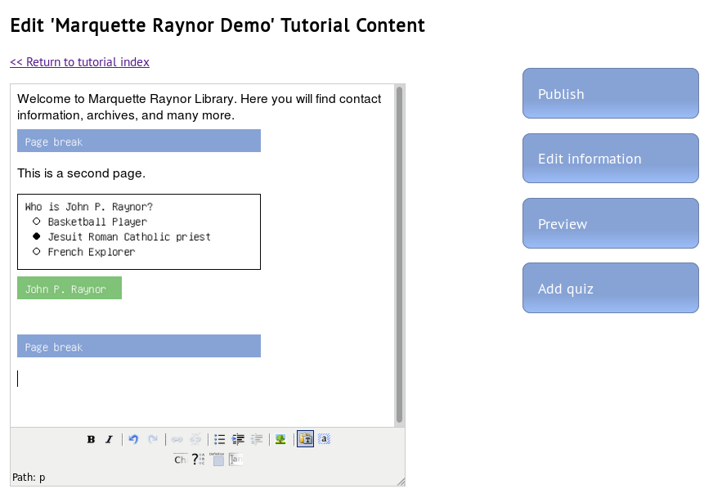
Adding pictures
Text can be boring. For the guide to be interesting, you need pictures.
Click here to add them.

Slide 27
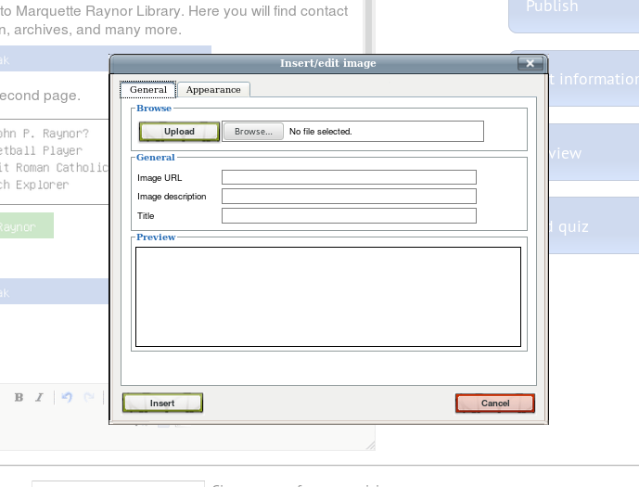
Here you can upload and set an Image URL. There’s many options dealing with Appearances. I’ll leave that for you to try.

Slide 28
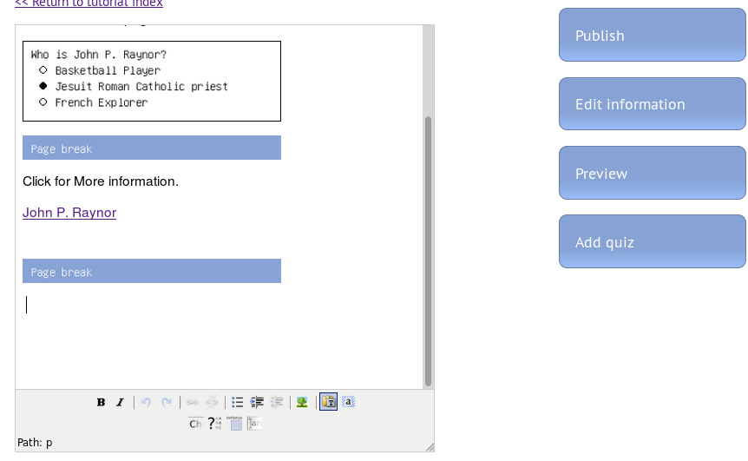
Adding Free Response Boxes
Can be used to ask deep questions for the user
Users are able to provide feedback
Click here to add a Free Response Box

Slide 29
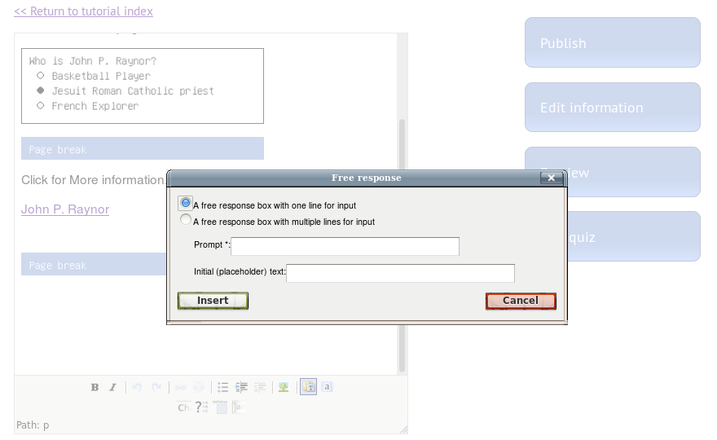
Here you can select various options. I recommend choosing the option with multiple lines for input.

Slide 30

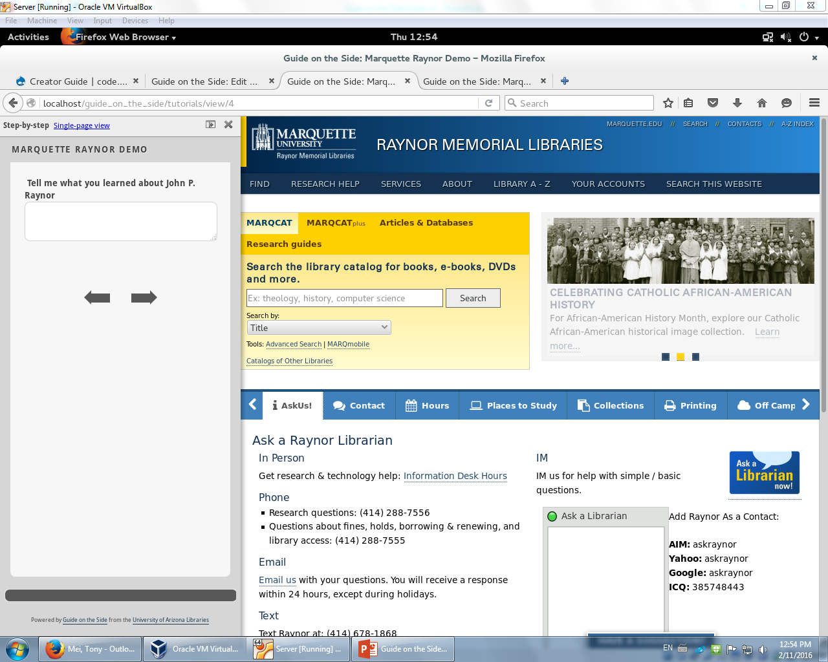

Slide 31
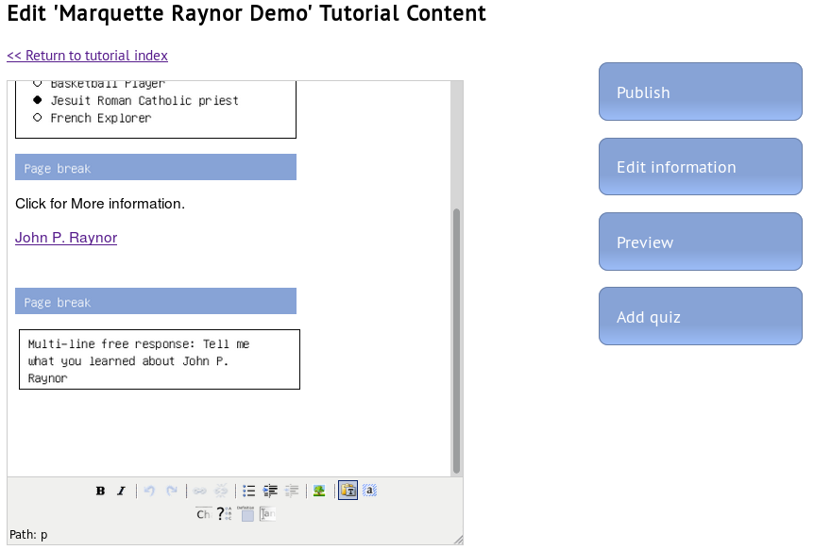
Adding a Quiz
Quiz can be used to test the knowledge of the user
Can assign a grade
Click here to add a quiz

Slide 32
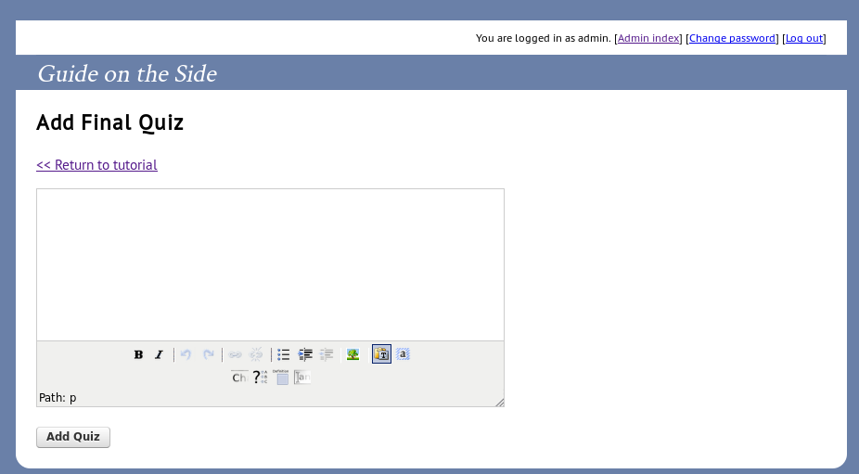
It will show the same editor where you can add questions and text and more.

Slide 33
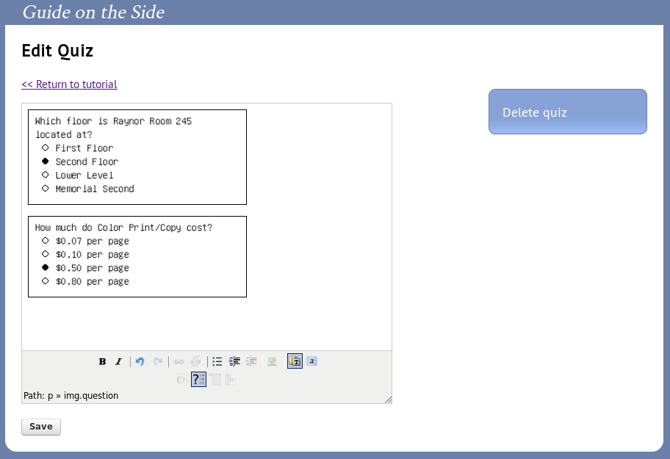
Here I added several questions. Be sure to click save and the Quiz will appear towards the end on the guide.

Slide 34
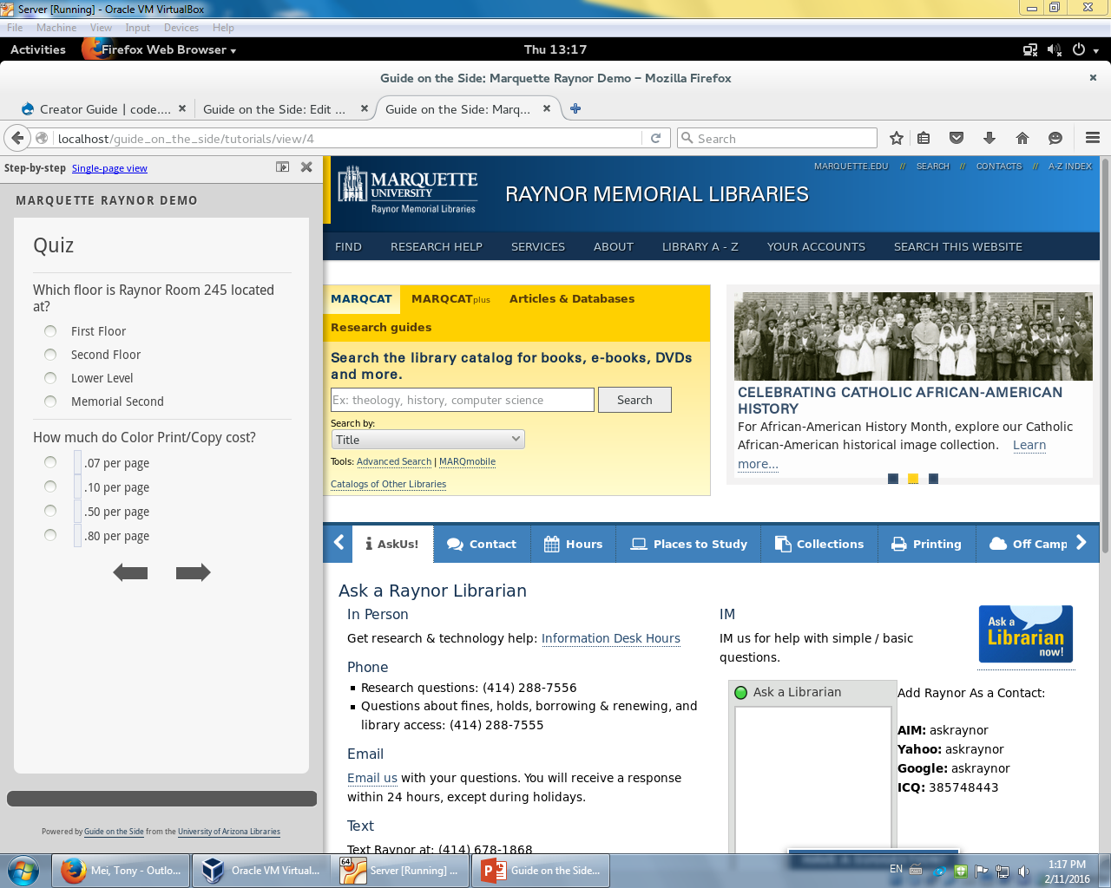
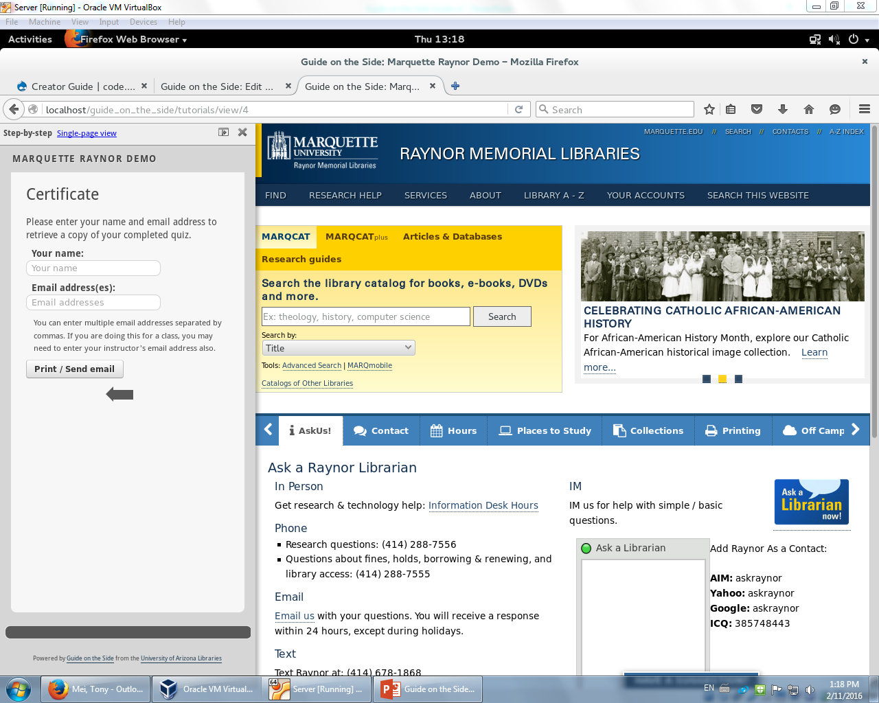
At the last page of the guide is where users can enter their information and retrieved their results.

Slide 35
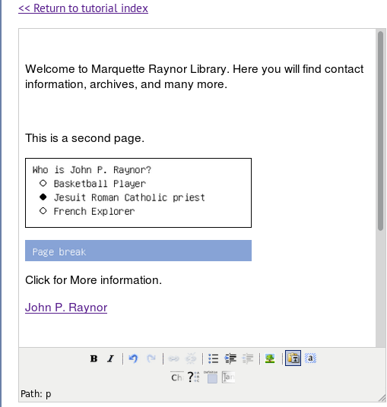
Adding Chapter Headings
If you really want to be fancy and organize your pages, you can add Chapter Headings
Click a spot where you wan to add a Chapter Heading and click this button

Slide 36
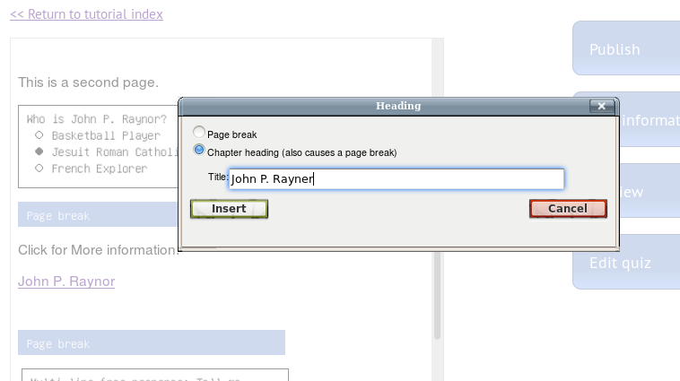
Select Chapter Heading and Put in a title.
Typo, but you get it.

Slide 37
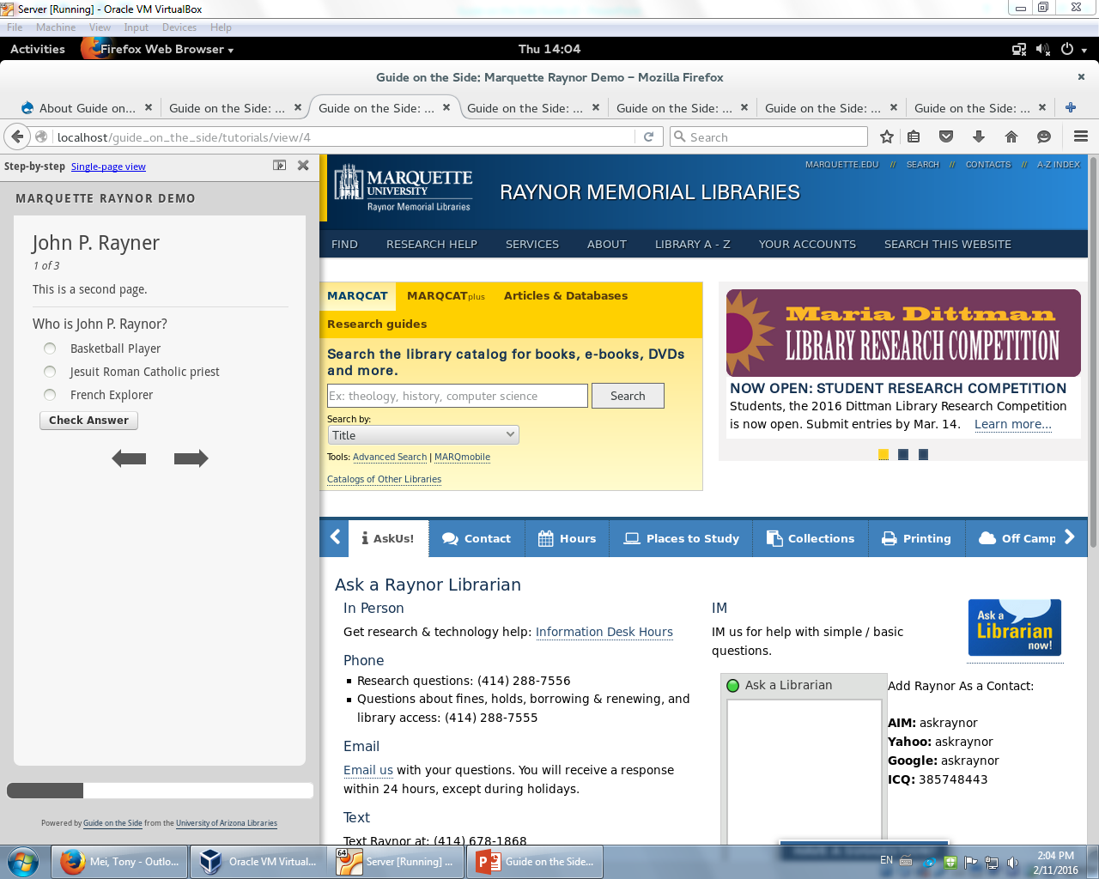
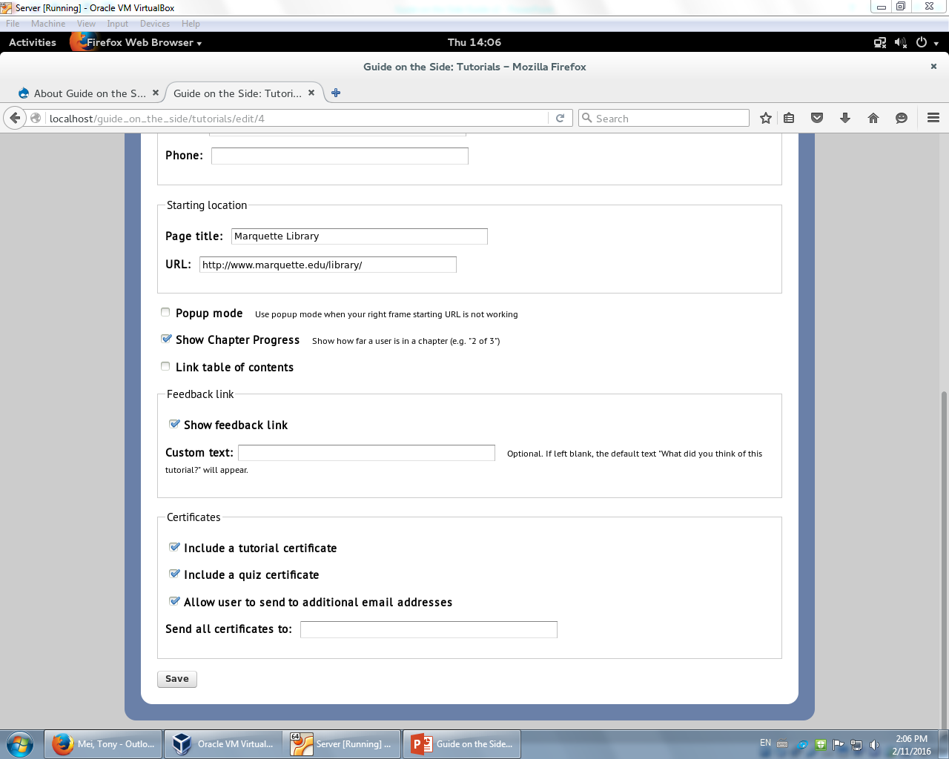
It shows the Chapter Heading at top as well as the page numbers. It’s good for organization. Be sure to add multiple Chapter Headings.
If you don’t see it, you need to enable Show Chapter Progress in Edit Tutorial Information

Slide 38
Other Settings

Slide 39
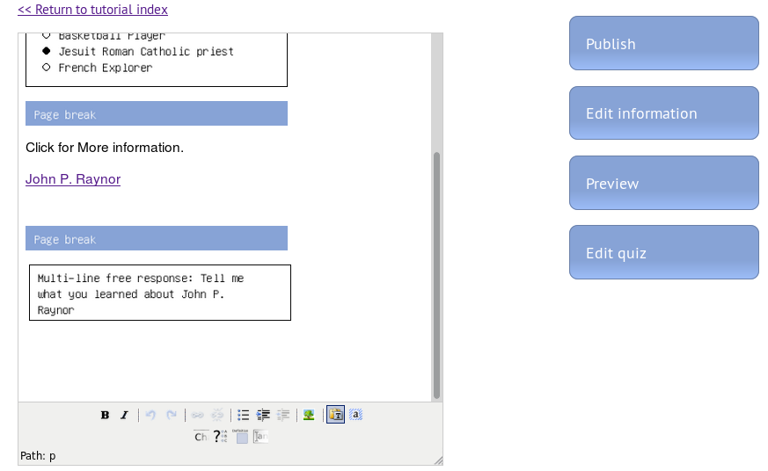
Guide on the Side as Popup
Guide on the side can be open as a popup instead of being on the side of a webpage.
Click here

Slide 40
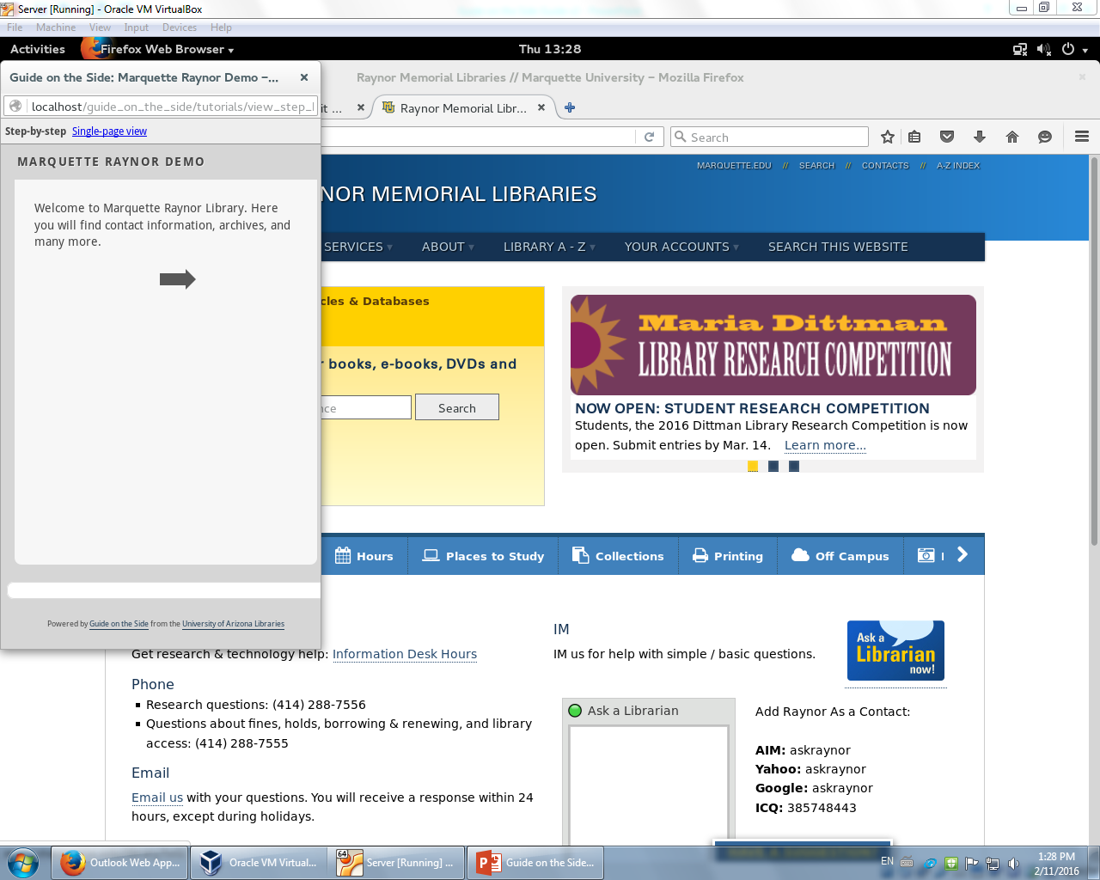
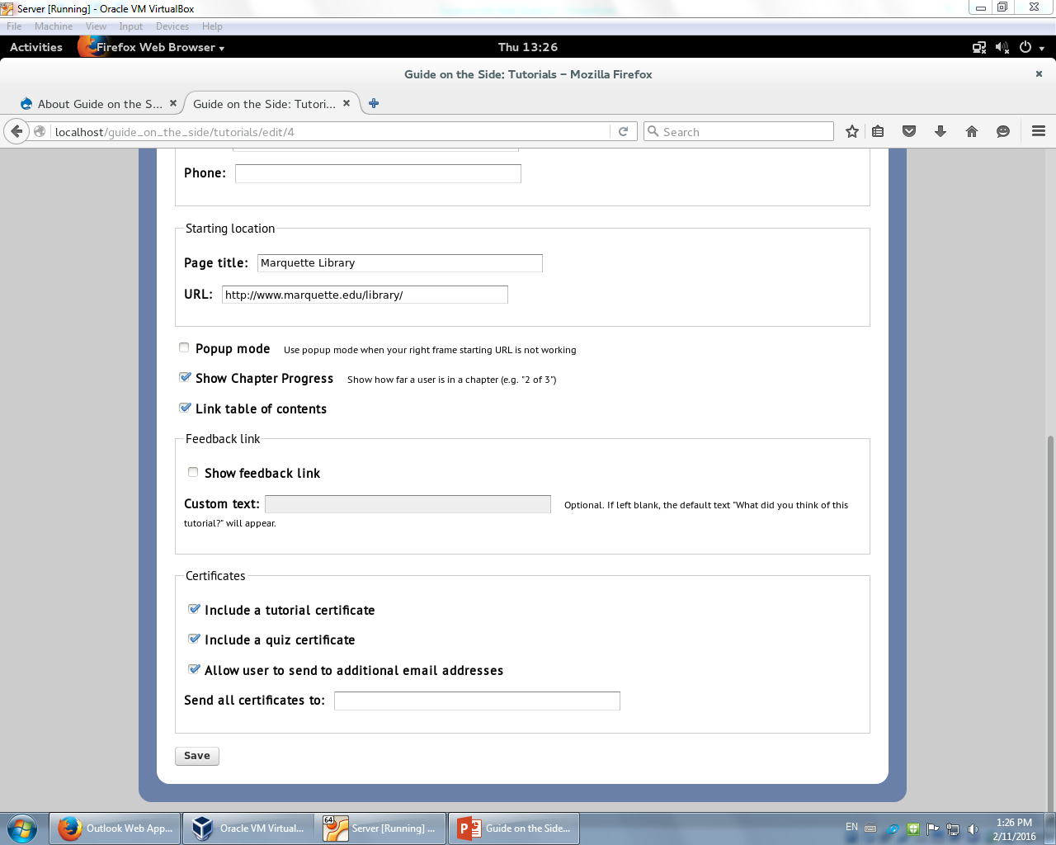
Scroll down so you can see Popup mode and have it checked.
Guide on the Side will load as a Popup

Slide 41
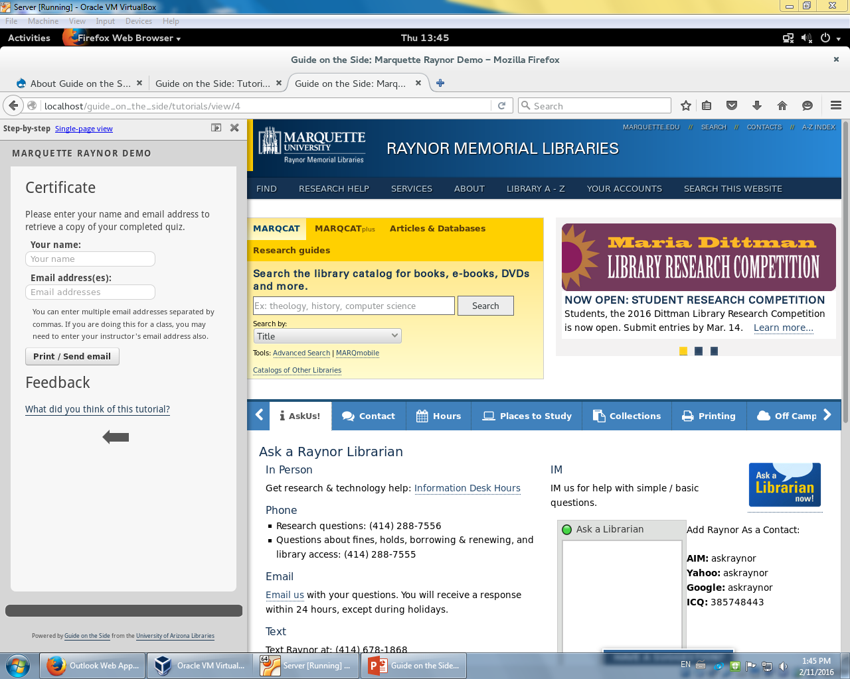
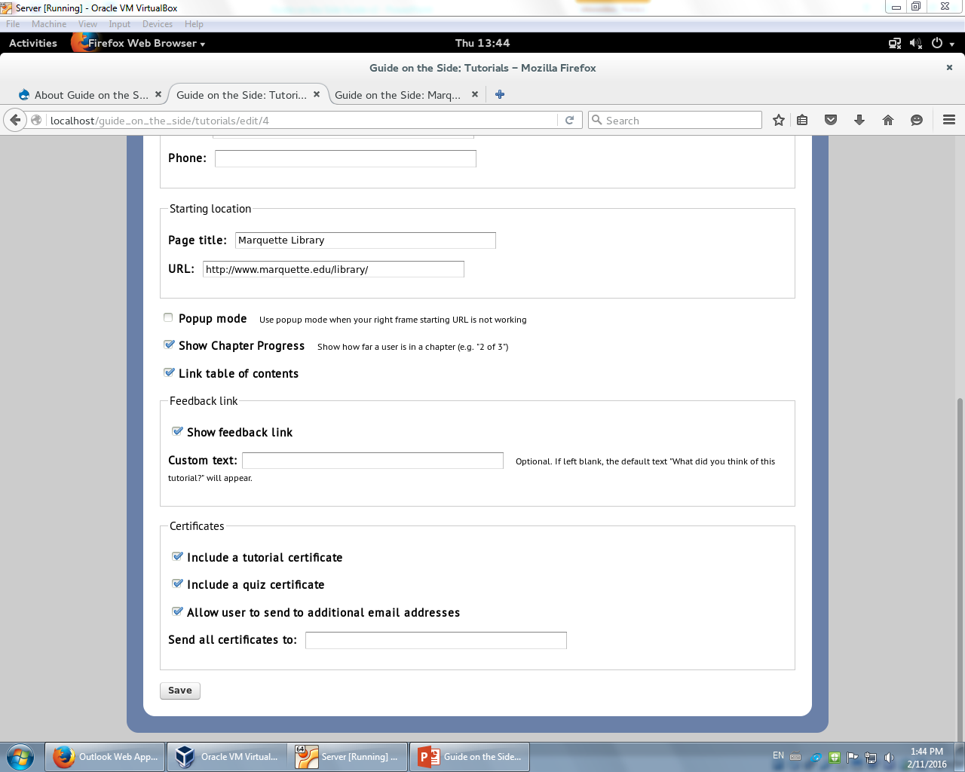
Adding feedback link
Add a place for user feedback at the end on the guide.

Slide 42
Conclusion
Here are more links for more tutorials: http://code.library.arizona.edu/gots/creator-guide http://code.library.arizona.edu/gots/style-guide
Advanced tutorial on Themes: http://book.cakephp.org/2.0/en/views/themes.html
But the best way to learn is to do it and explore!

